Slide 1
SOCIAL BOX FOUNDATION
" A small donation can make a huge difference."
Group Member
-Disha Jain
-Aayesha sipai

Slide 2
Project description
SBF provide user to request for donating old clothes and money for needed people. We want people to donate their clothes to goodwill instead of throwing them in the trash.
The project social box foundation (SBF) allow the admin to handle all the activities online.
admin can check the request daily and can review it.

Slide 3
CURRENT SYSTEM AND IT'S DRAWBACK
Donor is often required to visit the donation centers.
No location preferences exist.
There exists no pickup and delivery system.
In the existing system customer follow-up is difficult.

Slide 4
Proposed system
The social box foundation is designed for donating clothes.
People can donate clothes from their home through internet
It is computerized process that is easy to use and quick.
It is useful for the NGO and needy people.

Slide 5
FEATURES
Provide funding feature
Easy to use
Notification regarding new request
secure
Provide delivery service

Slide 6
SOFTWARE SPECIFICATION
1.Client :
Browser : any browser
2.Server :
Web browser : Google Chrome or any browser Programming language : PHP
Database server : MY SQL Web server : Apache
Operating system : Window server 2000 or equivalent
Other tool : MS PowerPoint 2016, MS Word 2016

Slide 7
HARDWARE SPECIFICATION
1. Client :
•Processor : 1.5GHz processor Speed
•RAM : 512MB
•Hard disk : 40GB
2. Server :
•Processor : 2.0GHz processor Speed
•RAM : 2GB
•Hard disk : 120GB

Slide 8
Waterfall Model
Requirement
collection
Design
Coding
Testing
Deployment
maintenance

Slide 9
Why we are using this model?
It give easy to control and clarity for the customer due to a strict reporting system.
Technology is well understood . It work well for small and low budget project.
Product definition is stable.
Requirement are very well understood.

Slide 10
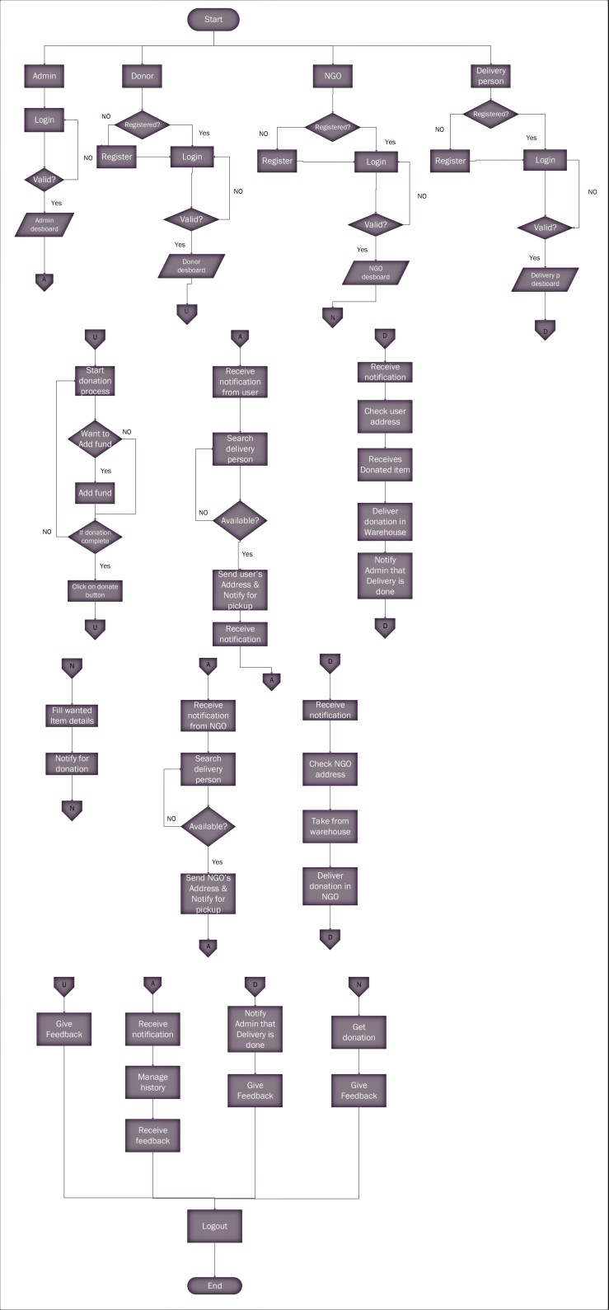
SFD

Slide 11
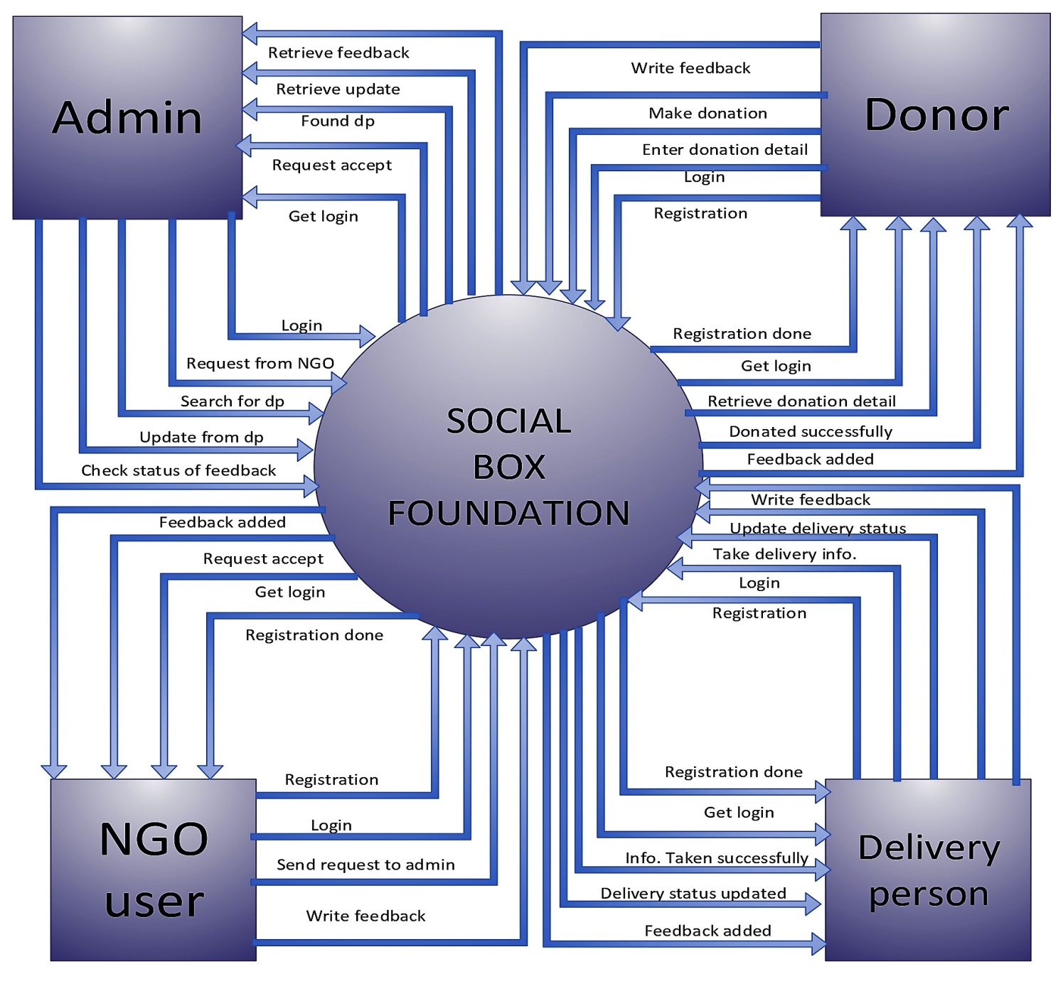
DFD Level 0

Slide 12
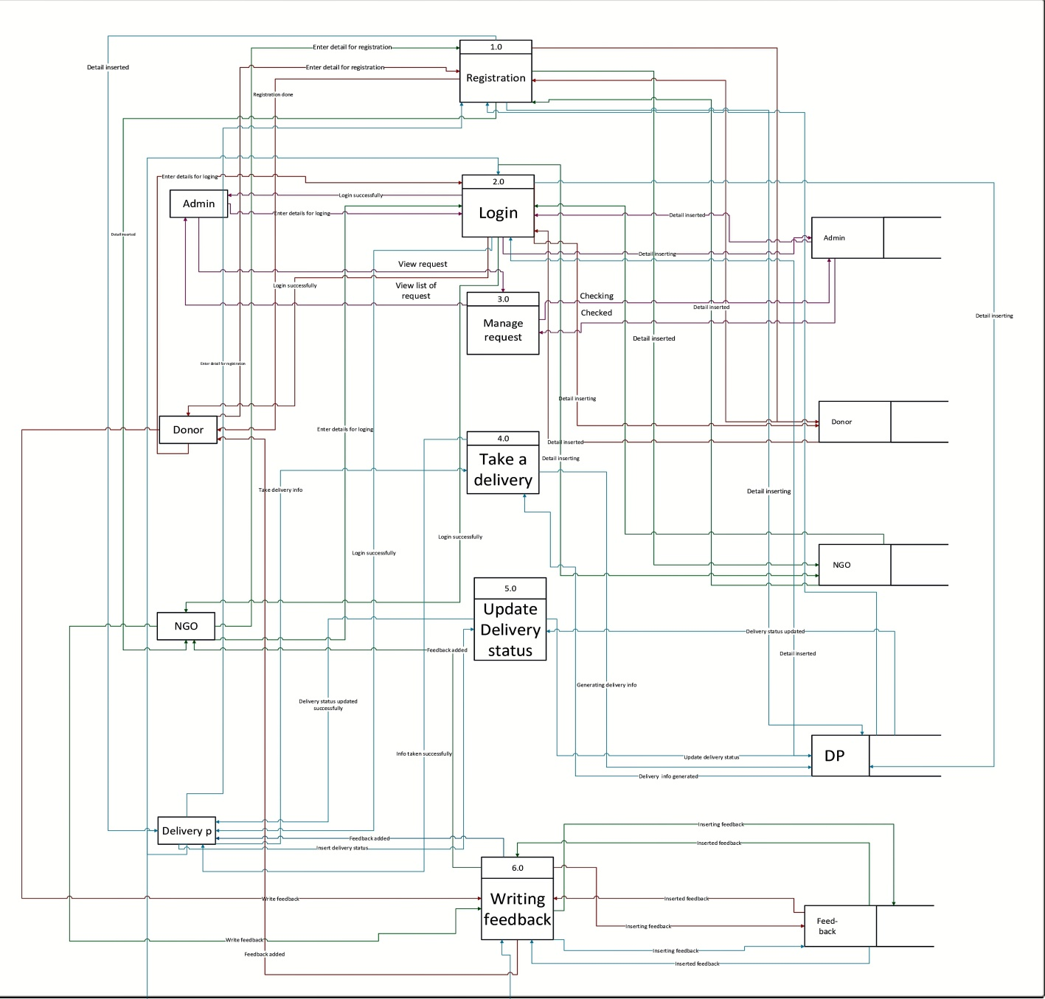
DFD LEVEL 1

Slide 13
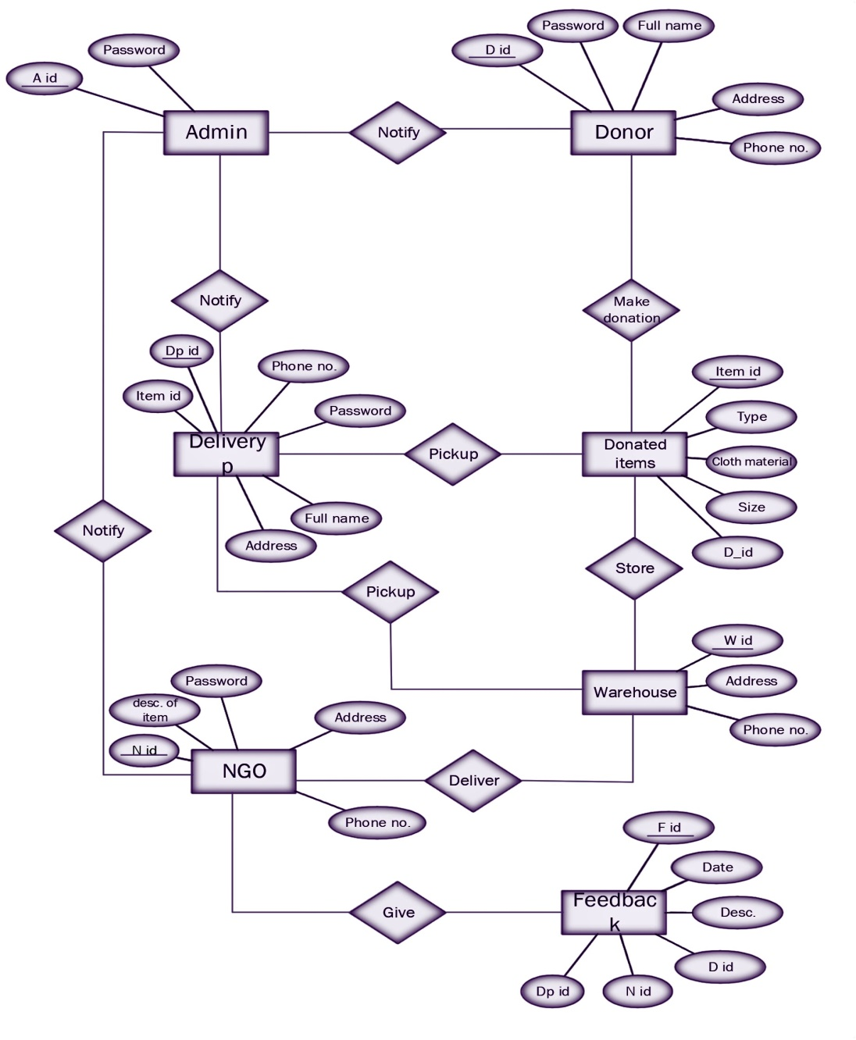
E-R Diagram

Slide 14
Data Dictionary:
Admin:
Field_name | Data type | Size | constraint | Description
Id | Int | 5 | Primary key | Unique id of admin
Password | varchar | 10 | Not null | Pass. Of admin
Full name | varchar | 20 | Not null | String username of admin
Email id | varchar | 20 | Not null | Email id of admin

Slide 15
Donor:
Field _name | Data type | Size | Constraint | Descirption
D_id | Int | 5 | Primary key | Unique id of donor
Password | Varchar | 10 | Not null | Pass.of donor
Full name | Varchar | 20 | Not null | Username of donor
Email_id | Varchar | 20 | Not null | Email of donor
Phone no. | Int | 10 | Not null | Phone no of donor
Address | Varchar | 30 | Not null | Add. Of donor

Slide 16
NGO:
Field_name | Data type | Size | constraint | Descirption
N_id | int | 5 | Primary key | Unique id of ngo
Password | Varchar | 10 | Not null | Pass.of ngo
Address | Varchar | 30 | Not null | Add. Of ngo
Phone no. | Int | 10 | Not null | Phone no of ngo
Email id | Varchar | 20 | Not null | eMail id of ngo
Detail of item | varchar | 50 | Not null | Item detial of ngo

Slide 17
Donated item:
Field_name | Data type | Size | Constraint | Descirption
Item | Int | 5 | Primary key | Detial of clothes
Type | Varchar | 10 | Not null | Type of donated item
Cloth material | Varchar | 10 | Not null | Material of clothes
Size | Varchar | 5 | Not null | Size of donated clothes
D_id | Int | 5 | Foreign key | Unique id of donar

Slide 18
Delivery person:
Field_name0 | Data type | Size | Constraint | Descirption
dp_id | Int | 5 | Primary key | Unique id of dp
Password | Varchar | 10 | Not null | Pass. Of dp
Full name | Varchar | 20 | Not null | Dp user name
Address | varchar | 30 | Not null | Add. Of dp
Phone no. | Int | 10 | Not null | Phone no. of dp
Item id | Int | 5 | Foreign key | Unique id for item

Slide 19
Feedback:
Field_name | Data type | Size | constraint | Description
Feed_id | Int | 5 | Primary key | Unique id od feed
Feed_date | Date | - | Not null | Date of feedback
Feed_desc | Varchar | 50 | Not null | Desceiption of feedback
D_id | Int | 5 | Foreign key | Id of donor
N_id | Int | 5 | Foreign key | Id of ngo
Dp_id | Int | 5 | Foreign key | Id of delivery person

Slide 20
Warehouse:
Field_name | Data type | Size | Constraint | Description
Warehouse_ id | int | 5 | Primary key | Unique warehouse id
Address | Varchar | 20 | Not null | Add. Of warehouse
Phone no. | Int | 10 | Not null | Phone no of ware house

Slide 21

HOME PAGE:

Slide 22
THANK YOU ☺
-Aayesha Sipai
-Disha Jain

